Slide 1

Forecasting Animal Shelter Intake: Insights and Recommendations
Using Advanced Analytics to Optimize Resources
Qianyi Yu
Notes:
Before diving into the project, I want to share a personal story that inspired this work. This is my cat, Smog, whom I adopted from a shelter in New York City this past May. During my visits to the shelter, I noticed a recurring challenge: the staff were often overwhelmed, and the shelter was sometimes overcrowded.
I also learned that Smog had been transferred from a shelter in Tennessee just two days before he arrived in New York. This made me curious about how shelters manage their resources and deal with fluctuating animal intake.
To explore this issue further, I found a dataset from a shelter in San Jose. My goal is to forecast the number of animals that might be brought into the shelter in the coming months. This forecast can help shelters optimize their staffing, food supplies, and other resources to provide better care for the animals.

Slide 2
Shelter Resource Challenges
Background
The animal shelter often faces seasonal surges in animal intake, creating resource planning challenges. For instance, one shelter recently experienced a spike in intake due to the Florida floods.
Forecast Questions
How many animals will the shelter intake daily over the next six months?
what trends and patterns should we expect?
Accurate forecasting is essential for ensuring the shelter has enough staff, food, and supplies without over- or under-allocating resources.
Notes:
After adopting Smog, I started receiving emails from the shelter. One email mentioned a significant intake of animals earlier this year due to the Florida floods, highlighting how external events can overwhelm shelters.
This makes the forecasting question even more crucial. With better planning, shelters can not only manage their resources effectively but also provide the right care to animals in need. Ultimately, I hope this analysis can help more pets find their forever homes by supporting better shelter operations and resource allocation.
To address this, I analyzed a dataset from a San Jose shelter, which includes over 52,873 records from 2022 to 2024. It tracks key details like intake dates, reasons for intake, and animal conditions.

Slide 3
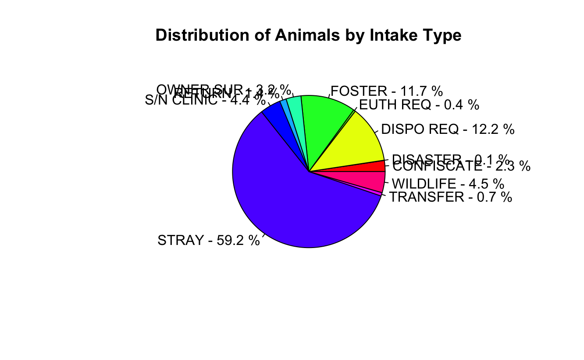
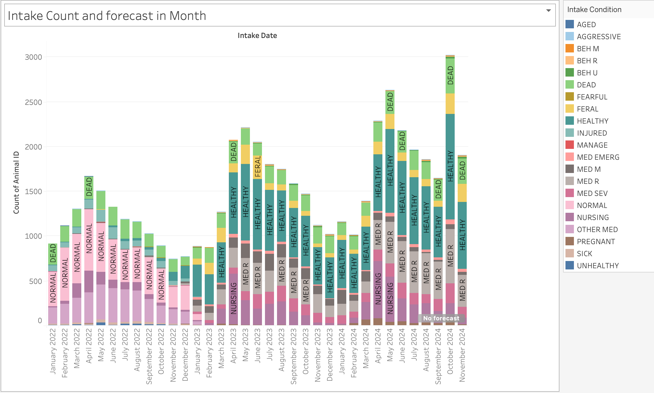
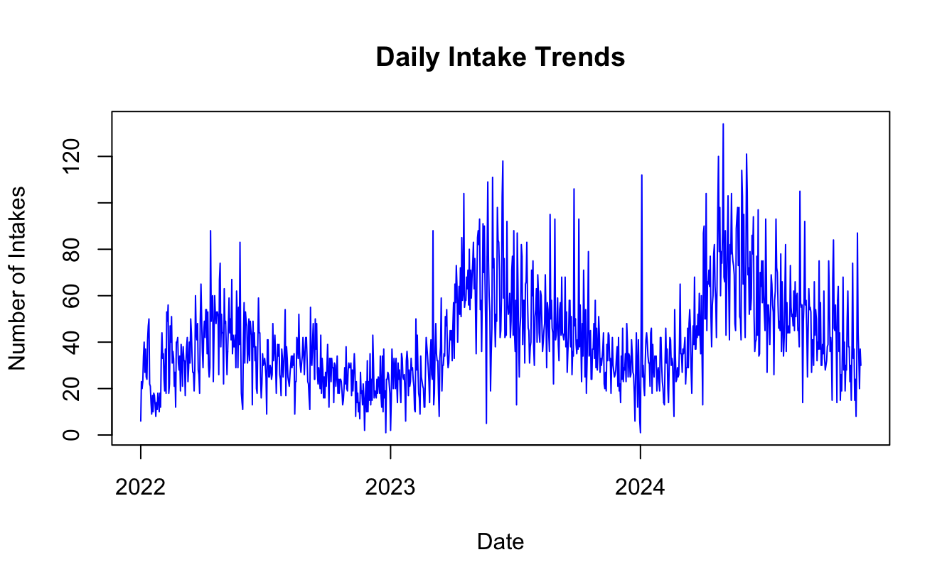
Data Overview and Insights
Source: San Jose Animal Shelter Intake and Outcomes Dataset
Timeframe: Filtered data from January 2022 to November 2024.
Key Variables in the Dataset:
Animal Type: Species of the animal (e.g., Dog, Cat, Bird, etc.).
Primary Color: The primary color of the animal.
Sex: The animal's gender (e.g., Male, Female, Unknown).
Intake Date: The date when the animal was taken into the shelter.
Intake Type: The reason or condition under which the animal was brought in (e.g., Stray, Owner Surrender).
Intake Condition: The physical condition upon intake (e.g., Normal, Injured).
Outcome Type: The outcome for the animal (e.g., Adoption, Transfer, Return to Owner).
Notes:
This dataset comes from the San Jose Animal Shelter and includes detailed records of animal intakes and outcomes. The data is filtered for the most recent timeframe, from January 2022 to November 2024, and contains key information such as animal type, primary color, sex, intake date, type, condition, and eventual outcomes like adoption or transfer.
To understand the dataset better, I performed some initial analysis. The pie chart on the top left shows that the majority of intakes—nearly 60%—are strays. The bar chart below highlights monthly trends in intake conditions, showing peaks in certain months. Finally, the line chart reveals the daily intake trends, with clear seasonal fluctuations that shelters must plan for.
These insights set the stage for the forecasting analysis, helping us better understand the challenges the shelter faces and why predicting future intake trends is so important.

Slide 4
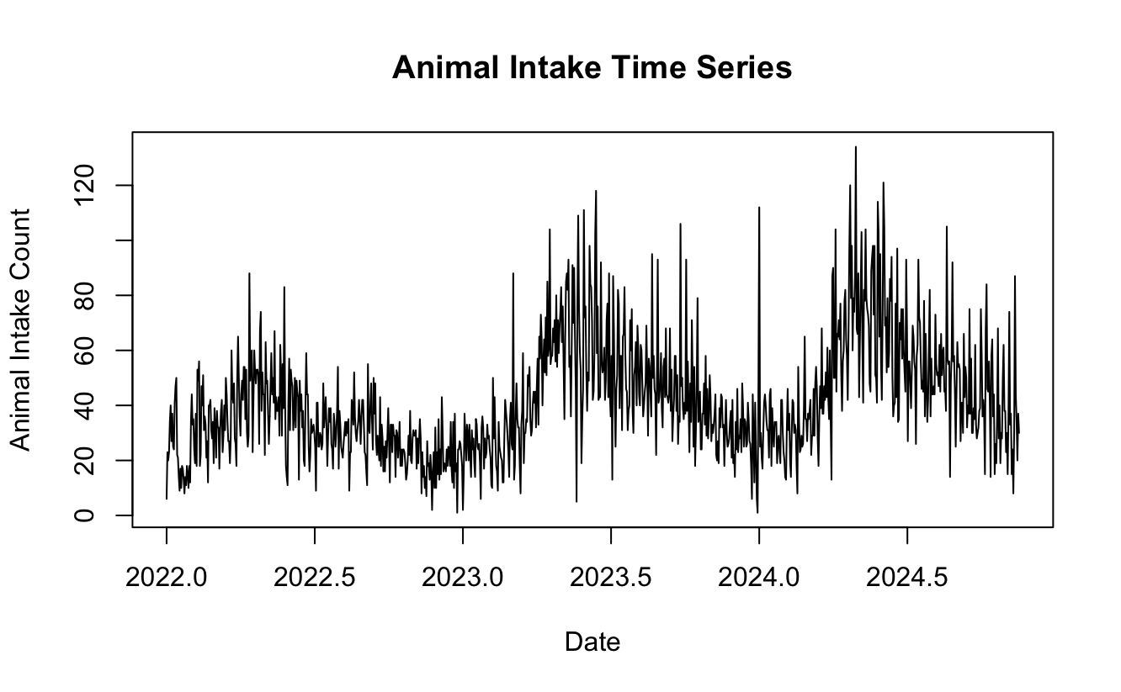
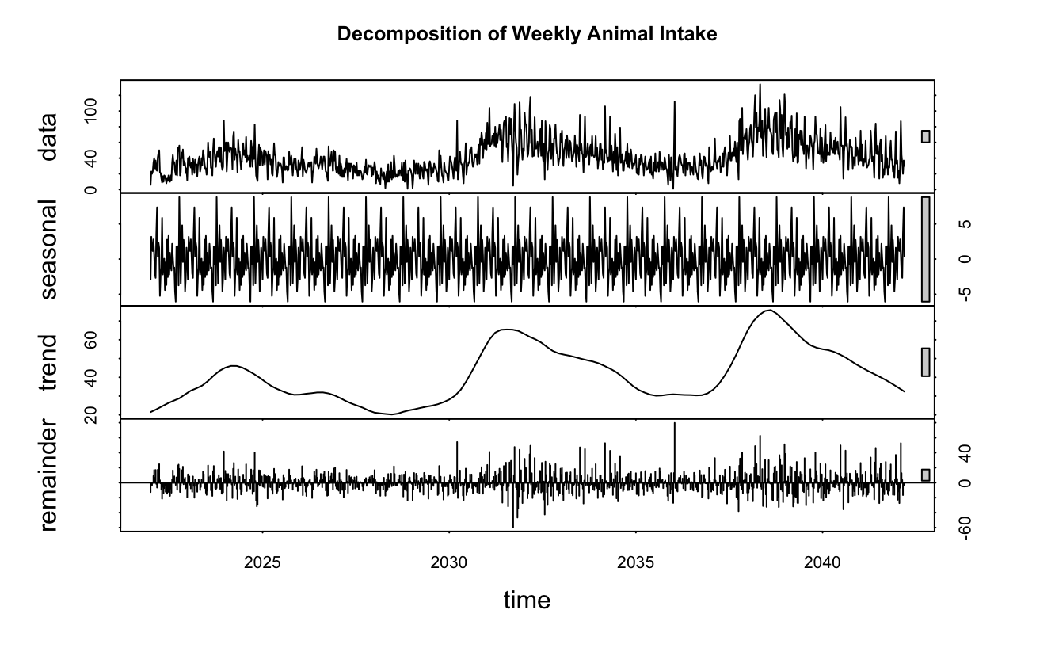
Time Series Analysis
Animal Intake Time Series:
Shows daily animal intake counts from 2022 to 2024, highlighting fluctuations over time.
Decomposition of Weekly Animal Intake:
Breaks down the data into three components:
Seasonality: Regular patterns that repeat annually.
Trend: Long-term upward or downward movement.
Remainder: Random noise or irregularities in the data.
Notes:
This slide shows the results of my time series analysis.
On the left, we see the daily animal intake counts from 2022 to 2024. This data clearly shows seasonal patterns, with consistent peaks and troughs over the years.
On the right, the decomposition of weekly intake data breaks this down further. The seasonal component captures recurring annual trends, the trend component reflects changes over time, and the remainder accounts for random noise.
While the seasonal and trend components make this dataset highly reliable, the random noise in the remainder indicates that unexpected events—like natural disasters—can cause spikes in intake.

Slide 5
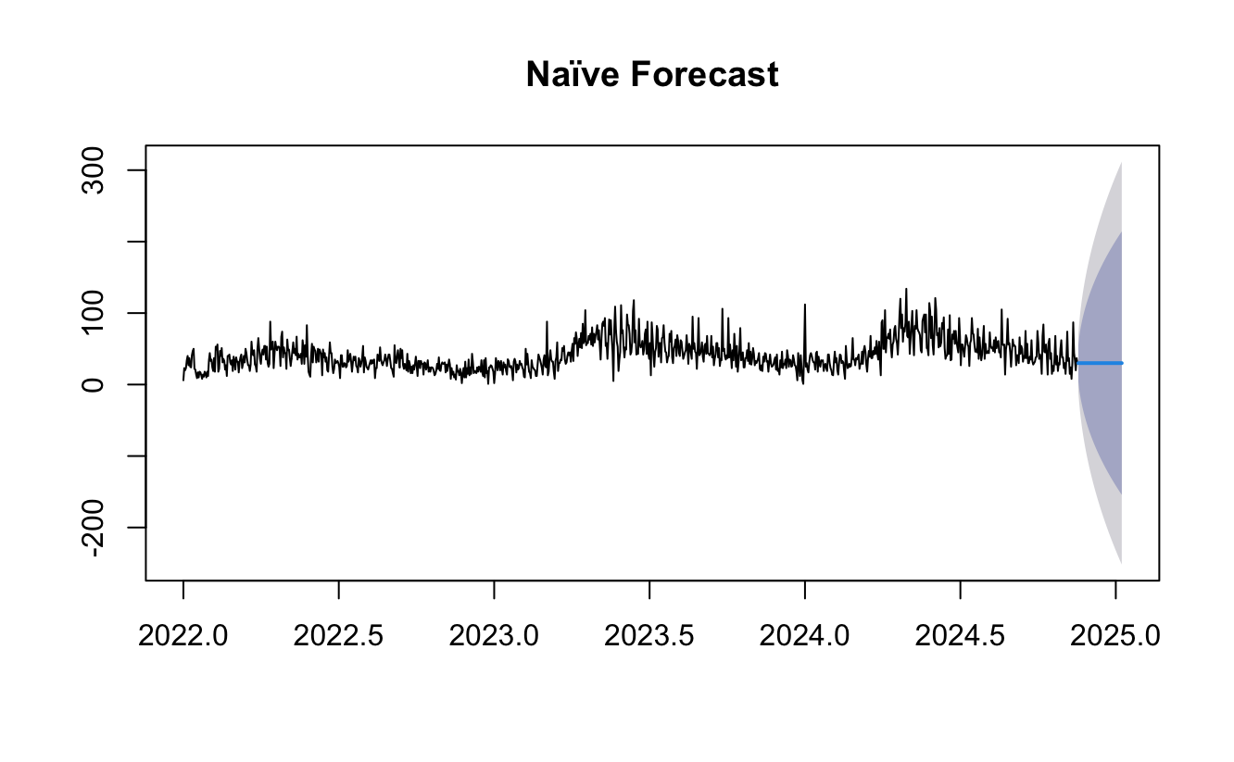
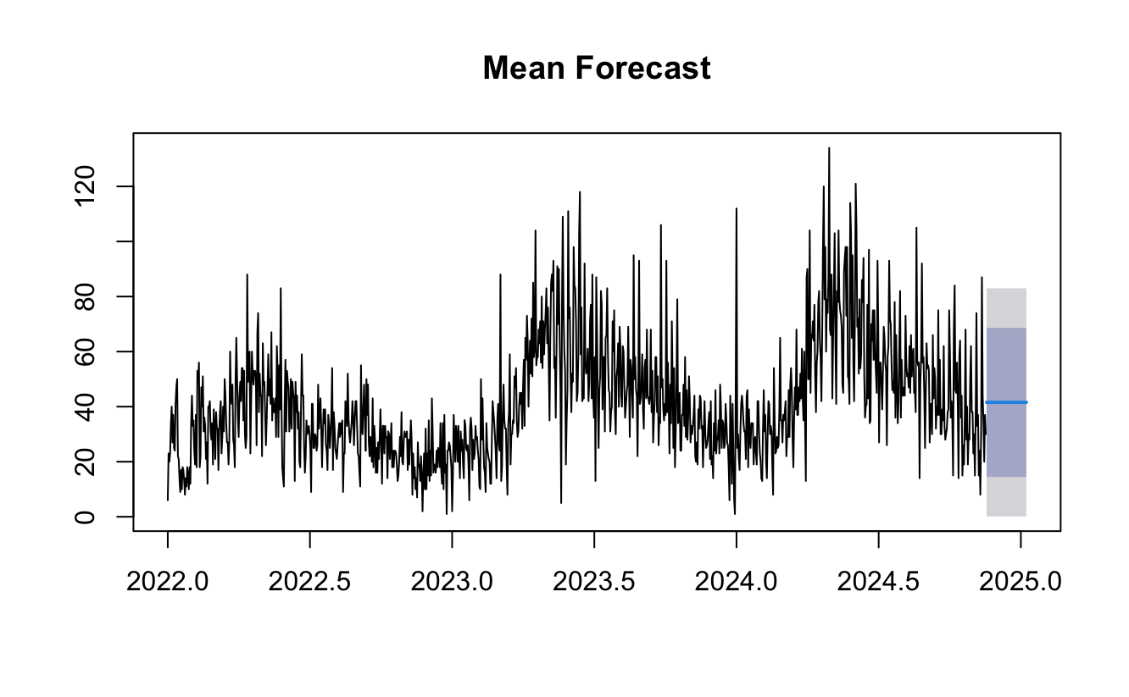

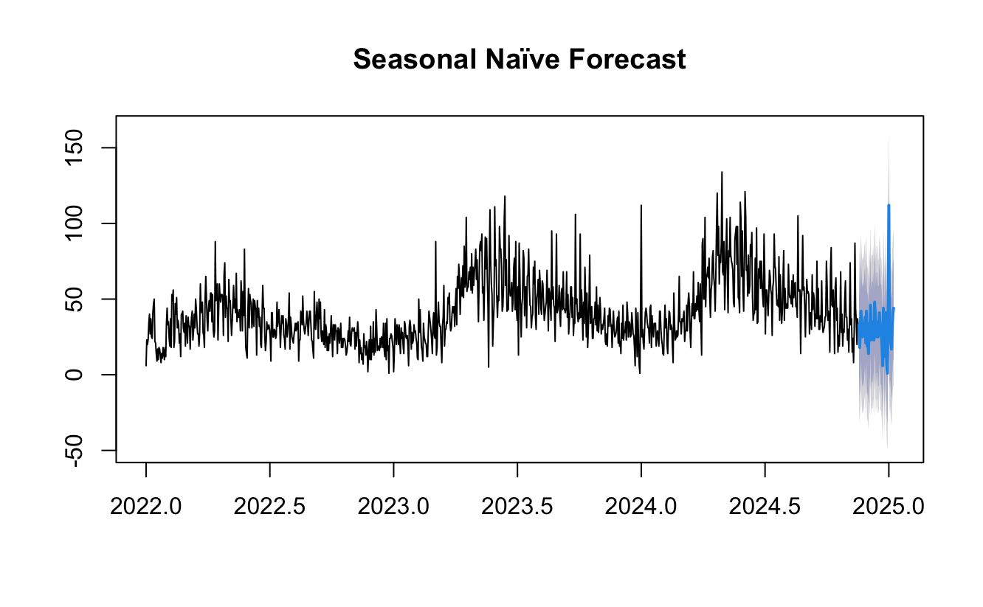
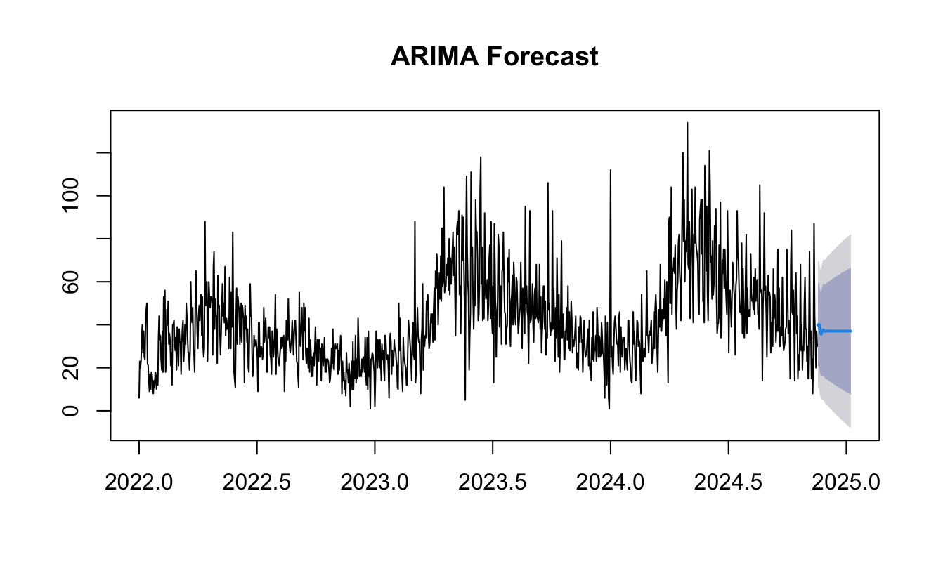
Forecasting Methods
Naïve Forecast: Assumes future intake will remain constant based on the most recent value. Simple but lacks accuracy for fluctuating patterns.
Mean Forecast: Predicts using the average of past intakes, smoothing out daily fluctuations but ignoring trends and seasonality.
Seasonal Naïve Forecast: Builds on seasonal patterns, effectively capturing recurring peaks and troughs in the data.
ETS Forecast: Highlights trends and seasonal patterns, offering a smooth and balanced prediction curve.
ARIMA Forecast: Captures both short-term fluctuations and long-term patterns for detailed and reliable forecasting.
Notes:
This slide presents the forecasting methods I used and the key insights from each.
First, the Naïve Forecast assumes future intake will simply match the most recent value. While it’s quick and straightforward, it doesn’t account for seasonal or trend changes, so its accuracy is limited.
The Mean Forecast averages past data to predict future intake, smoothing out daily variations. However, it doesn’t reflect the seasonal peaks or trends we’ve observed in the dataset.
The Seasonal Naïve Forecast improves on this by incorporating recurring patterns. For example, it predicts future peaks and dips based on seasonal trends, making it a more practical model for our dataset.
The ETS Forecast adds flexibility by capturing both seasonal patterns and underlying trends. This makes it a well-rounded method for our shelter’s planning needs.
Lastly, the ARIMA Forecast combines short-term fluctuations with long-term trends, providing a detailed and reliable prediction. This method works well with the structured patterns seen in our data.
By comparing these methods, we can identify the best fit for accurately forecasting shelter intake and supporting resource planning.

Slide 6
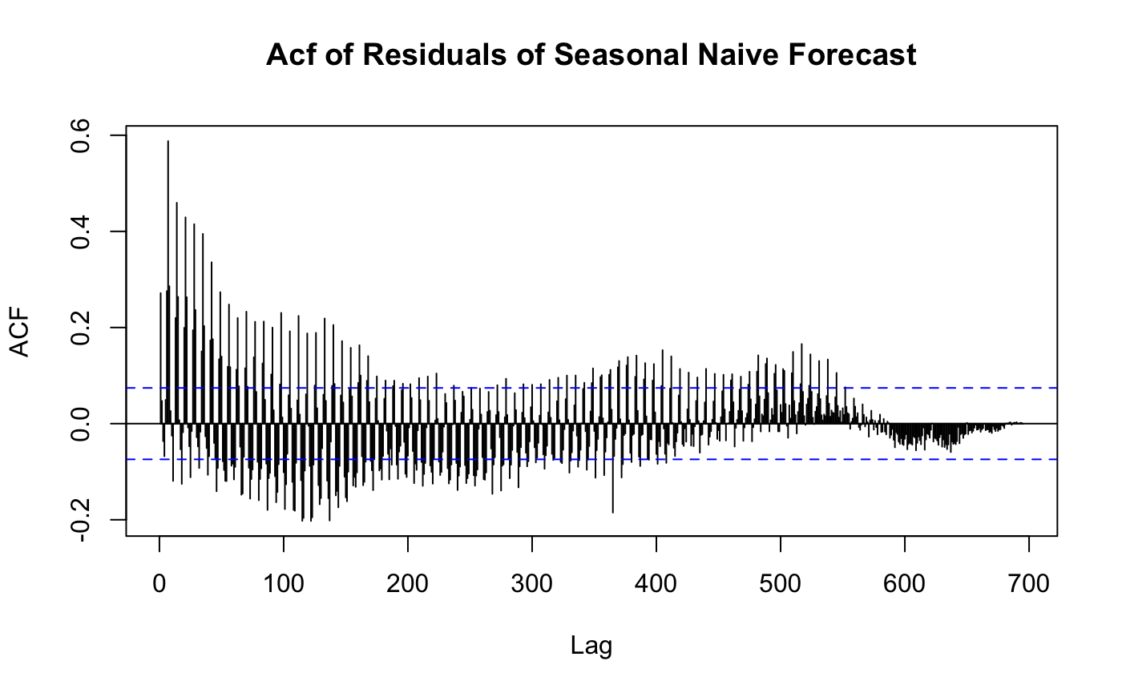
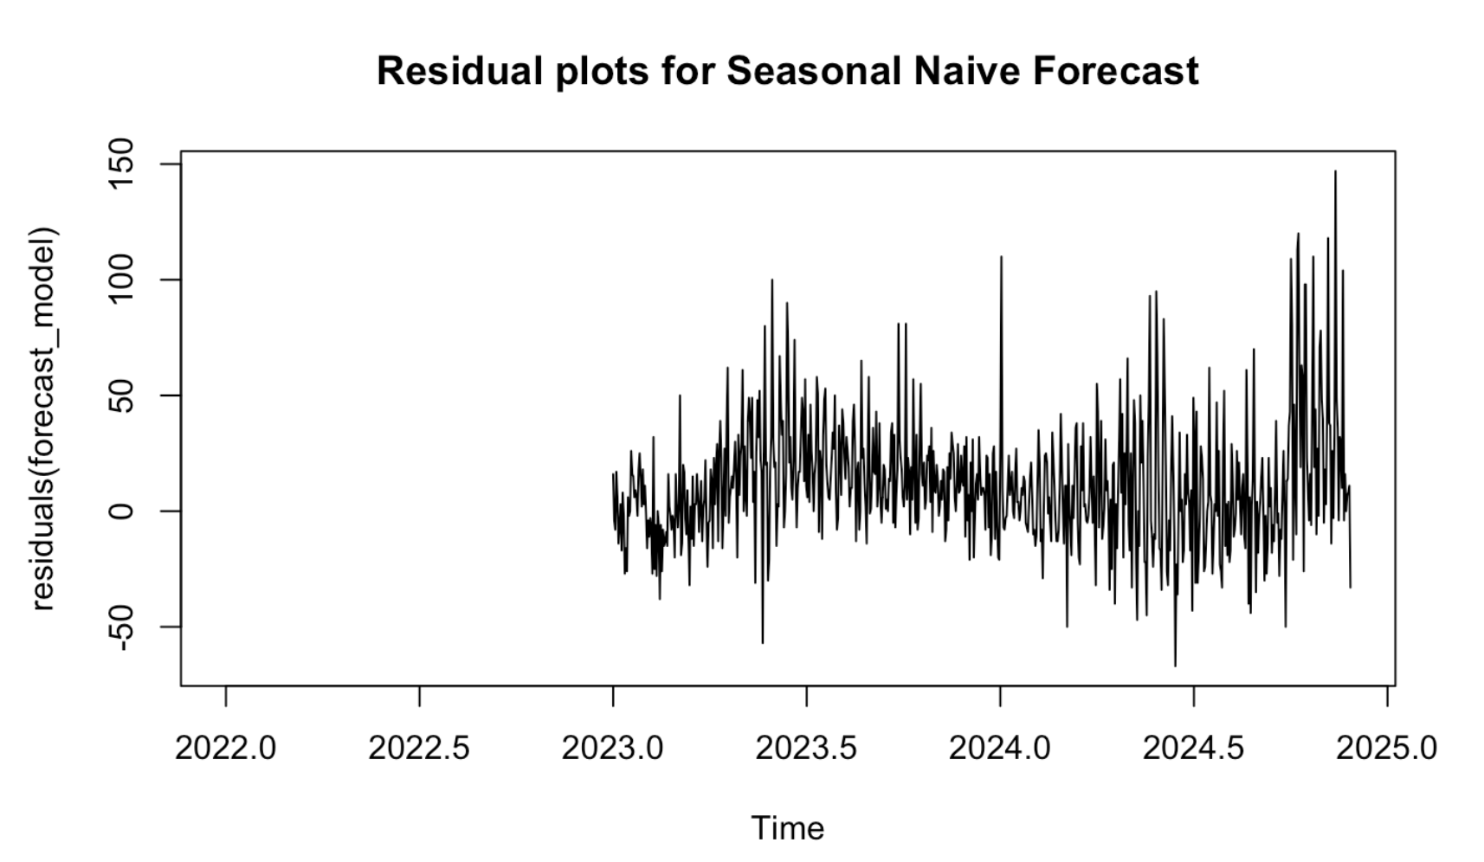
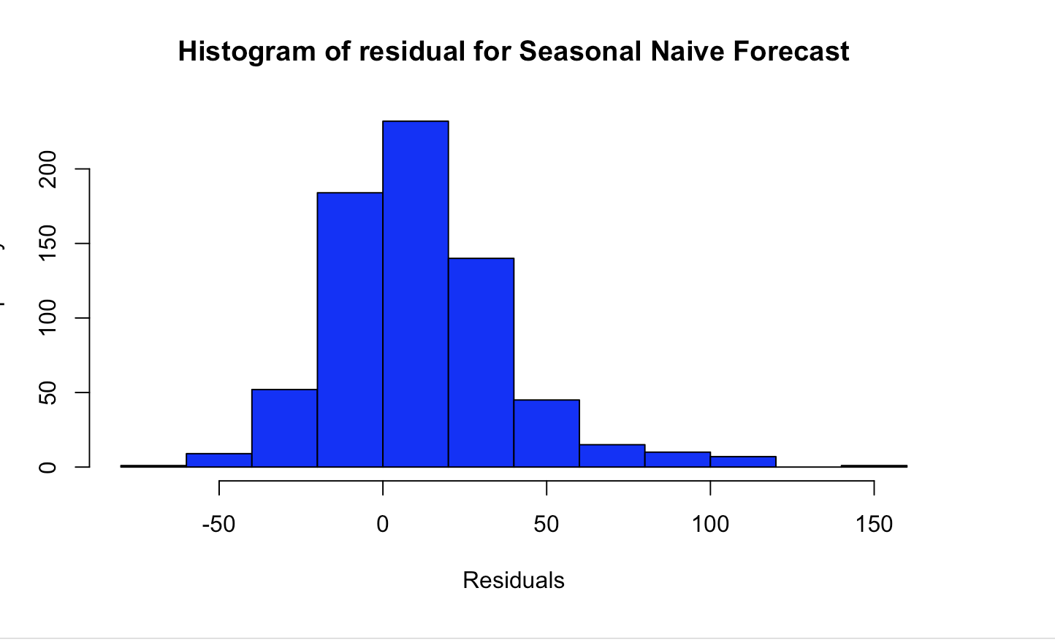
Residual Analysis – Seasonal Naïve Forecast
Residual Plot: Tracks residuals over time, helping assess model stability.
ACF Plot: Highlights autocorrelation in residuals to check if the model has captured patterns effectively.
Histogram: Shows the residuals’ distribution, ideally resembling a normal curve.
Notes:
This slide presents the residual analysis for the Seasonal Naïve Forecast, which is a critical step in evaluating model performance.
The residual plot tracks the difference between the forecasted and actual values over time. Here, we can see some fluctuations, but overall the model shows stability.
The ACF plot helps us assess whether there are any patterns left in the residuals. Ideally, we want no significant spikes, as that would indicate the model has captured the key seasonal and trend components effectively.
Lastly, the histogram shows the distribution of residuals. A near-normal distribution, as seen here, indicates that the model’s errors are unbiased and well-distributed.

Slide 7
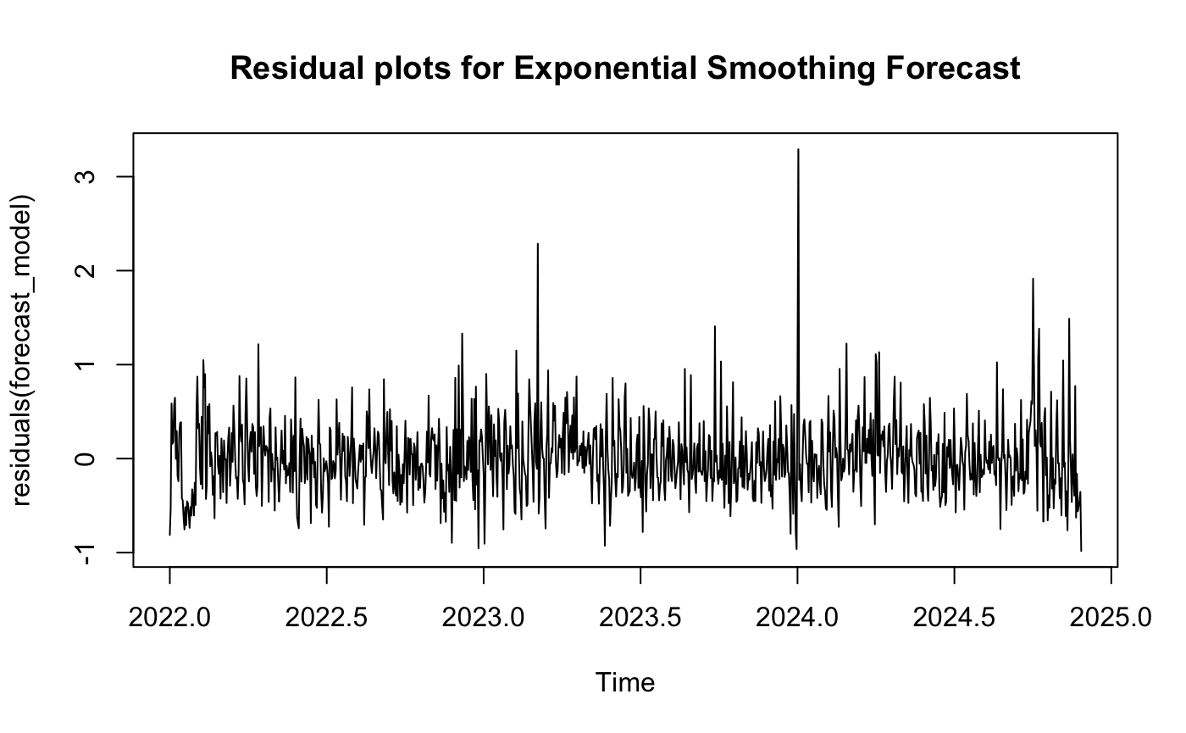
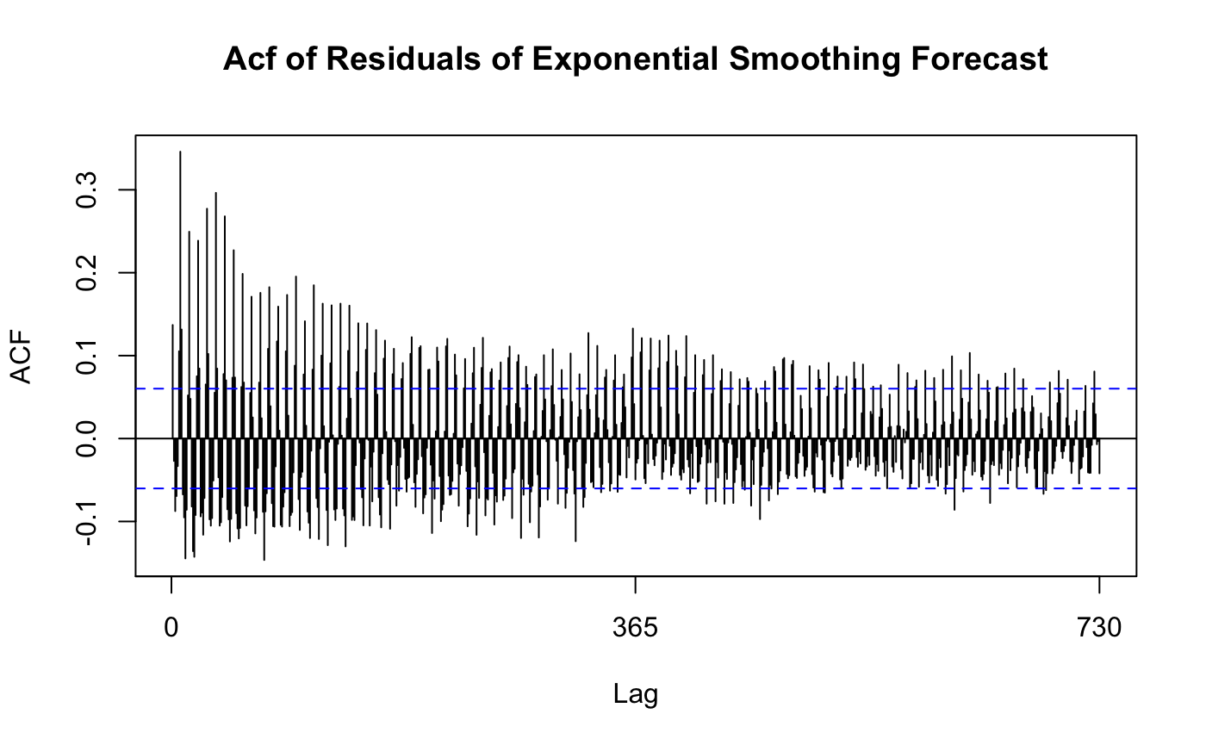
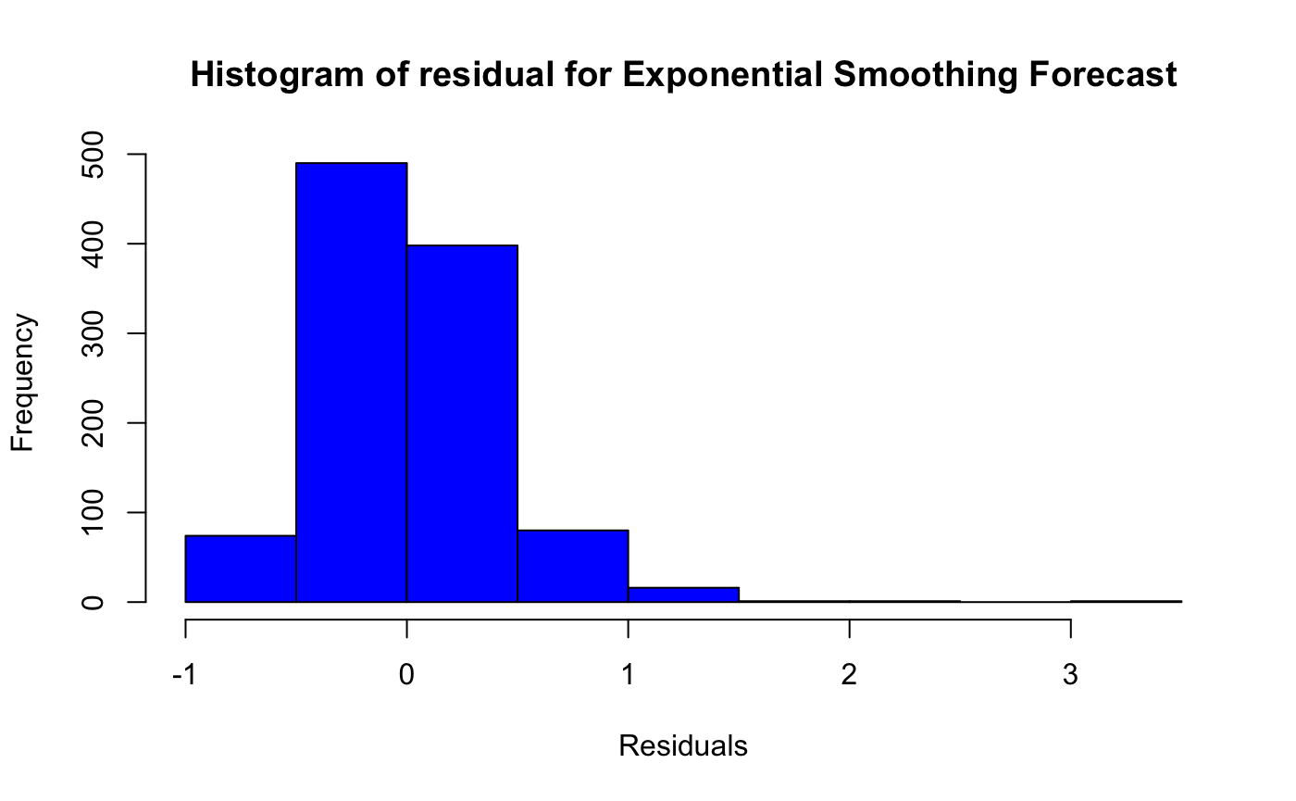
Residual Analysis – Exponential Smoothing
Residual Plot: Residuals are relatively stable over time, with some occasional spikes.
ACF Plot: Small autocorrelations indicate that most patterns are captured well.
Histogram: Residuals are centered around zero, showing no significant bias.
Notes:
This slide shows the residual analysis for the Exponential Smoothing Forecast.
The residual plot shows that the residuals are generally stable over time, with only a few larger spikes. This suggests the model captures most patterns accurately but occasionally struggles with outliers.
The ACF plot shows small autocorrelations, meaning the model has successfully captured the key trends and seasonal patterns, with little leftover structure in the residuals.
Finally, the histogram indicates that the residuals are centered around zero and roughly symmetric, showing no strong bias in the forecast.

Slide 8
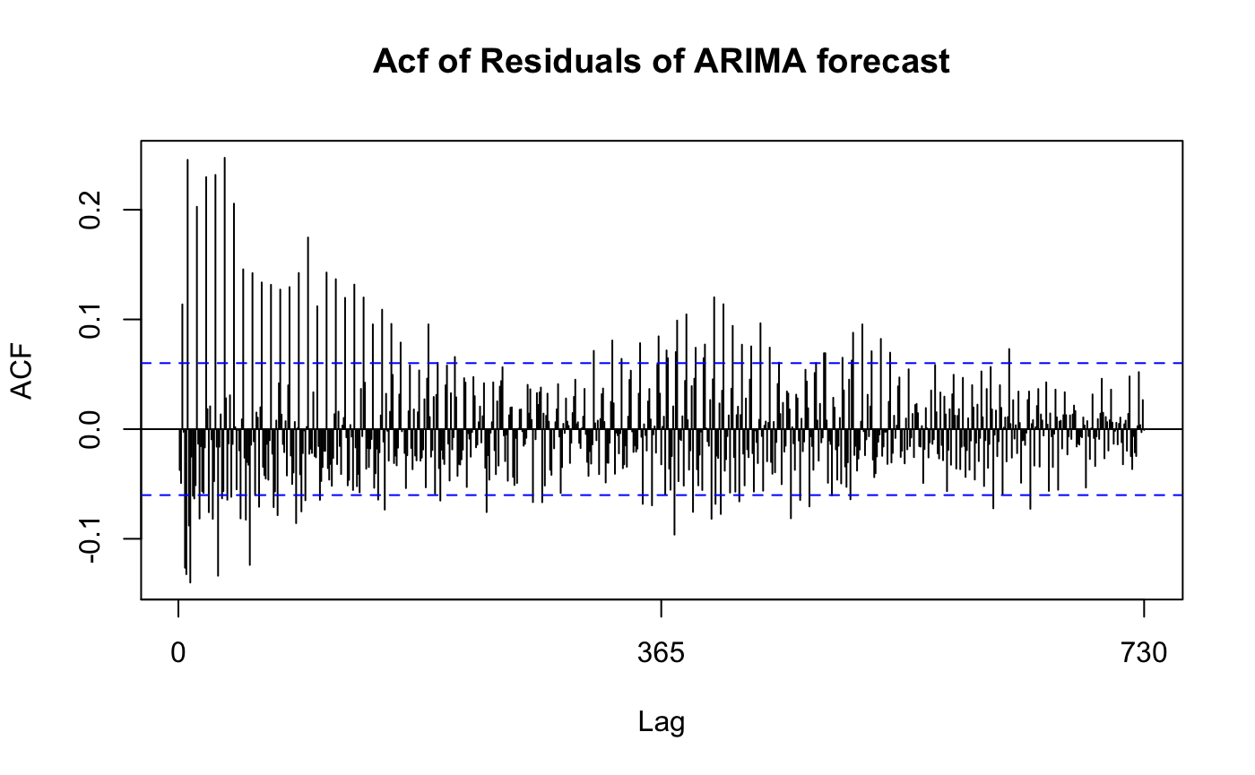
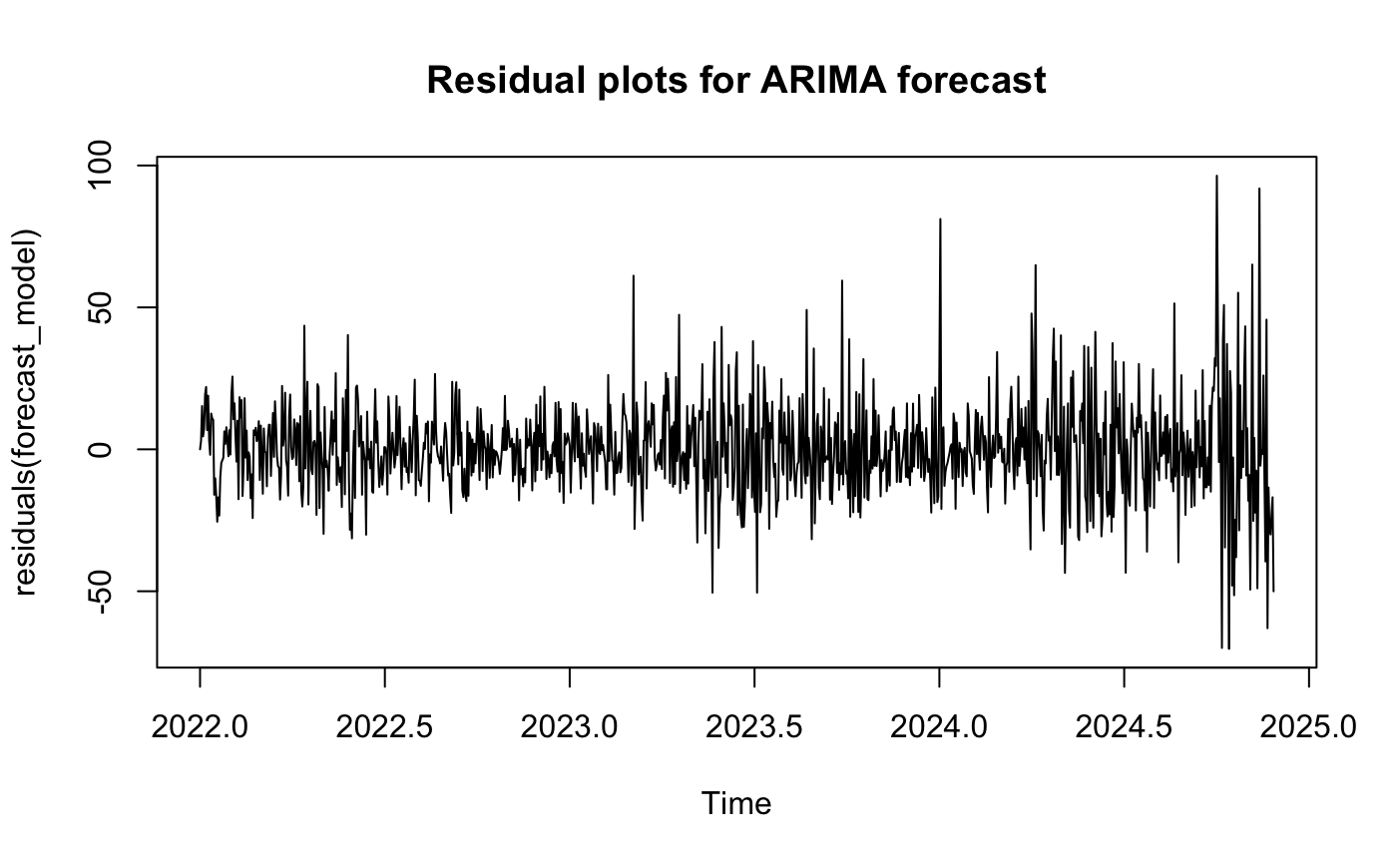
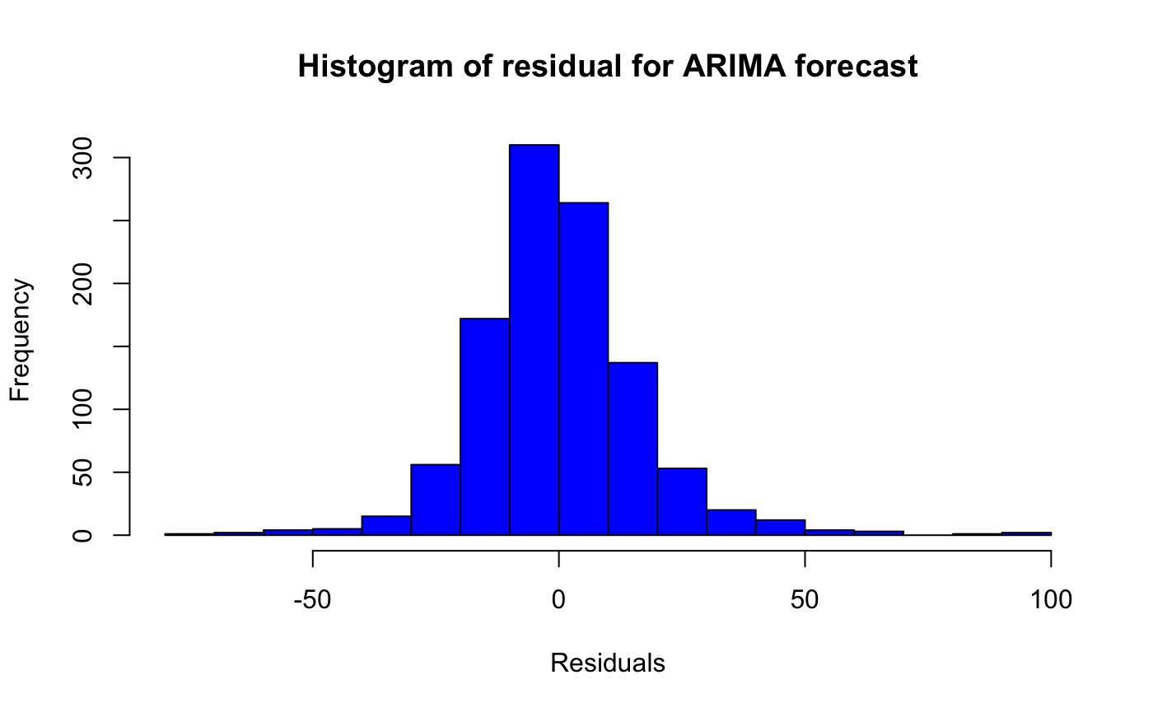
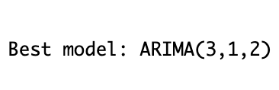
Residual Analysis – ARIMA
Residual Plot: Residuals are stable with minimal large spikes.
ACF Plot: No major autocorrelation, indicating the model captures patterns well.
Histogram: Residuals are symmetric and centered around zero, showing good model fit.
Best Model: ARIMA(3,1,2).
Notes:
This slide shows the residual analysis for the ARIMA forecast, specifically for the selected model: ARIMA(3,1,2).
The residual plot demonstrates that the residuals are stable over time, with minimal large spikes. This indicates that the ARIMA model has captured most of the patterns in the data.
The ACF plot reveals no significant autocorrelation left in the residuals, confirming that the model has accounted for trends and seasonality effectively.
The histogram shows that the residuals are symmetrically distributed around zero, suggesting unbiased and random forecast errors.

Slide 9
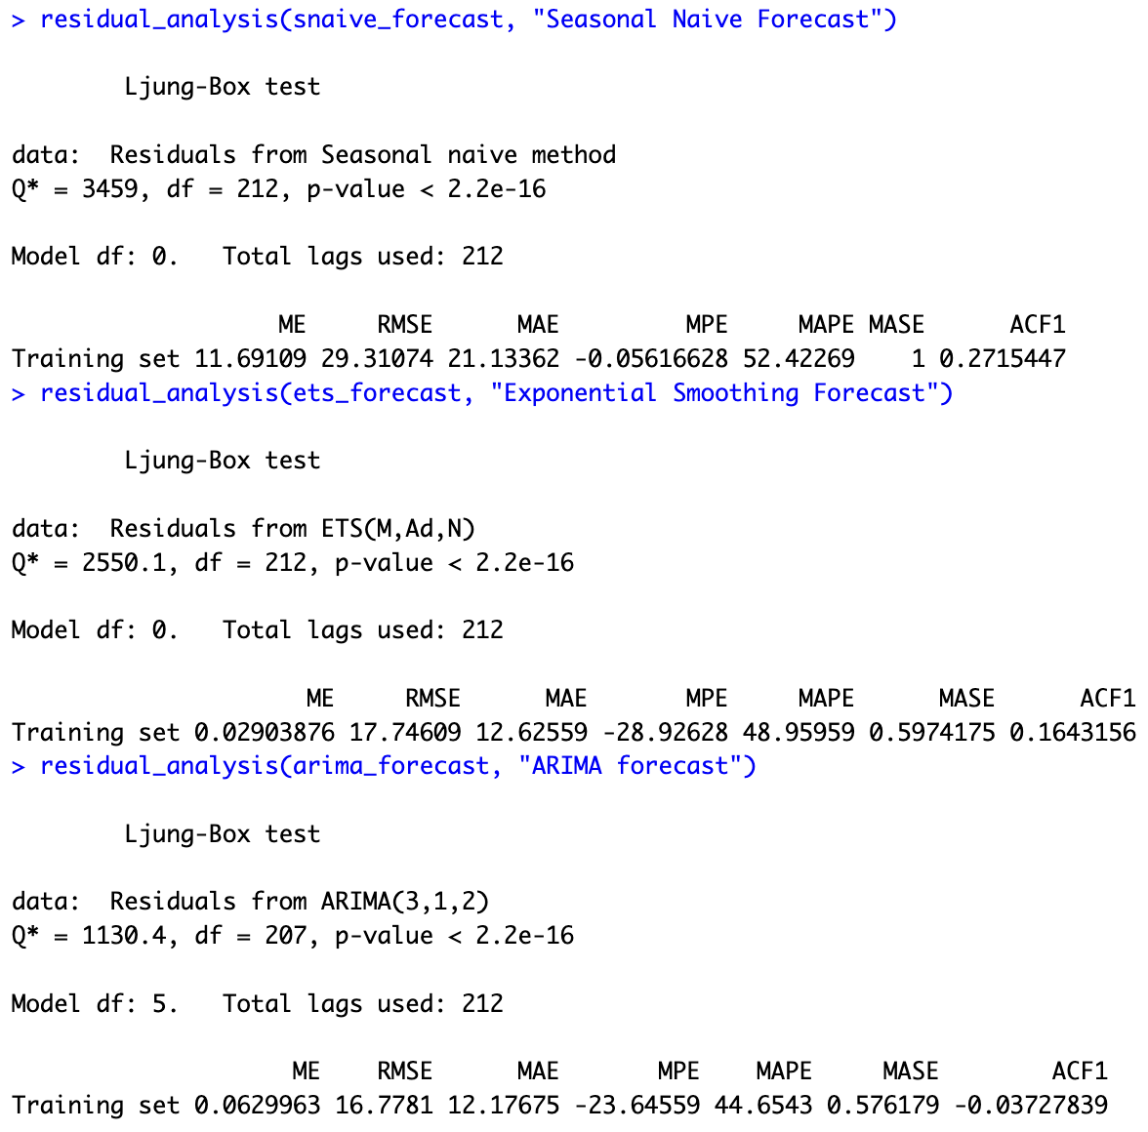
Prediction Accuracy and Model Comparison
Chosen Accuracy Measure: MAPE
Measures forecast errors as a percentage of actual values.
Helps assess how significant errors are relative to intake volumes.
Why MAPE is Important:
Easy to interpret and compare across models.
Highlights how well forecasts align with actual needs.
Model Comparison (MAPE Results):
Seasonal Naïve: 52.42%
Exponential Smoothing: 48.96%
ARIMA (3,1,2): 44.65%
Notes:
For this project, I chose MAPE—Mean Absolute Percentage Error—as the primary accuracy measure. MAPE calculates errors as a percentage of the actual values, which makes it easy to understand and compare across different forecasting methods.
MAPE is particularly important for me because it shows how significant the errors are relative to the shelter’s intake volumes. For example, a small percentage error means the forecast is closely aligned with the shelter’s actual needs, which is crucial for planning resources like staff, food, and space.
When comparing models:
The Seasonal Naïve method had the highest MAPE at 52.4%, making it the least reliable.
Exponential Smoothing improved on this with a MAPE of 48.96%.
Finally, the ARIMA (3,1,2) model had the lowest MAPE at 44.65%, showing the best overall performance and the closest alignment with actual intake.
This is why I’ve chosen ARIMA as the best forecasting method—it provides the most accurate and reliable results for resource planning.

Slide 10
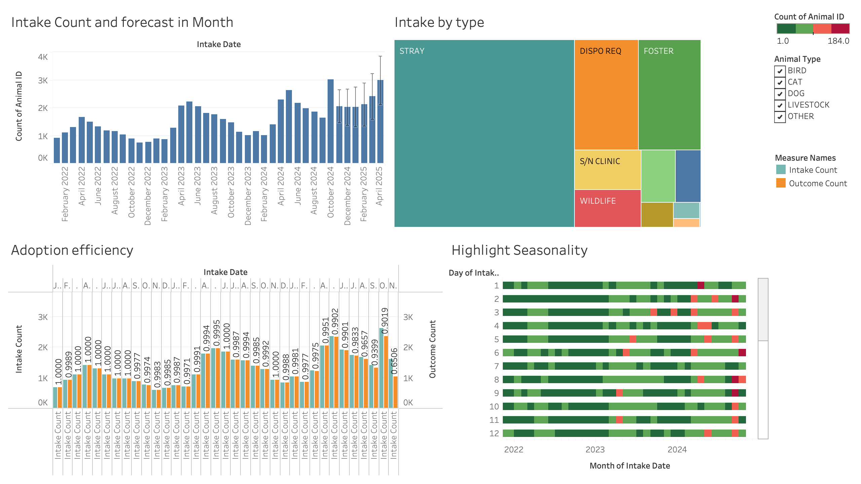
Notes:
This slide incorporates Tableau visualizations to provide additional insights beyond what the ARIMA model shows in R. While ARIMA focuses on statistical rigor and precise forecasting, Tableau helps us see broader patterns and seasonality more clearly.
For example, the monthly intake trends and adoption efficiency visualizations from Tableau illustrate seasonal peaks and highlight adoption trends that weren’t as explicitly displayed in the ARIMA outputs. The heatmap of seasonality is another example of how Tableau captures detailed daily and monthly patterns in intake and outcomes.
As for the forecasting differences:
Tableau uses an exponential smoothing approach (ETS), which adapts to trends and seasonality automatically, making it a great tool for identifying overarching patterns.
ARIMA, on the other hand, was selected for its statistical robustness and ability to handle complex data relationships through manual tuning.
Using both tools together gives a more complete picture—Tableau provides visual clarity, while ARIMA offers statistical depth and reliability for forecasting accuracy.

Slide 11
Key Forecast Insights and Recommendations
Forecast Insights:
Seasonality: Intakes peak during spring and summer, with a decline in winter.
Stray Animals: The majority of intakes are strays, creating consistent demand for resources.
Adoption Trends: Adoption rates remain high, but recent efficiency dips may signal a need for intervention.
Future Intake: Forecasted increases in early 2025 suggest preparation for higher intake volumes.
Recommendations:
Staffing: Increase staff availability during intake peaks in spring and summer.
Resources: Allocate more food, space, and supplies to handle forecasted growth in intake.
Outreach: Enhance stray management programs to address the primary source of intakes.
Adoption Support: Investigate recent dips in adoption efficiency and improve promotion efforts.
Notes:
This slide summarizes the key insights from the forecasts and actionable recommendations based on the findings.
First, the forecasts highlight clear seasonal patterns, with intake volumes peaking during spring and summer and declining in winter. Most of these intakes are strays, indicating consistent demand for resources to manage this group. While adoption rates remain high, a slight dip in efficiency in recent months may signal a need for additional support. Looking ahead, the forecast shows a potential increase in intakes in early 2025, requiring proactive planning.
Based on these insights, I recommend the following:
Increase staffing during seasonal peaks to ensure the shelter can handle higher intake volumes.
Allocate resources like food, space, and supplies to meet forecasted demands, especially during peak months.
Enhance outreach programs for stray management to reduce intake pressure on the shelter.
Investigate adoption efficiency dips and improve promotion or support for adoptions to maintain high rates.

Slide 12
Improvement Ideas
Data Preparation
Outlier Treatment: Outliers can distort the model's understanding of trends. To reduce their effect, apply strategies like Winsorization or IQR filtering.
Missing Data Handling: Use simple methods to fill in any gaps in the data, such as linear interpolation or or replacing missing values with averages. This guarantees data consistency and prevents forecasting errors.
Advanced Modeling
Exponential Smoothing (ETS): Utilize ETS models to explore different combinations of error, trend, and seasonality. This approach is strong for capturing smoother trends and patterns.
Hybrid Models: Combine ARIMA with ETS or introduce machine learning techniques like Random Forest or other methods to reveal non-linear relationships and improve forecast accuracy.

Slide 13


Thank You

